Slide 1
CHAPTER 19
Parallel programming and
computational thinking

Slide 2
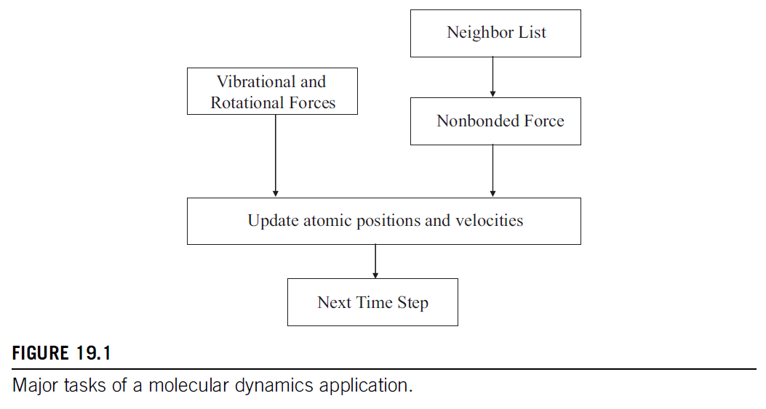

Slide 3
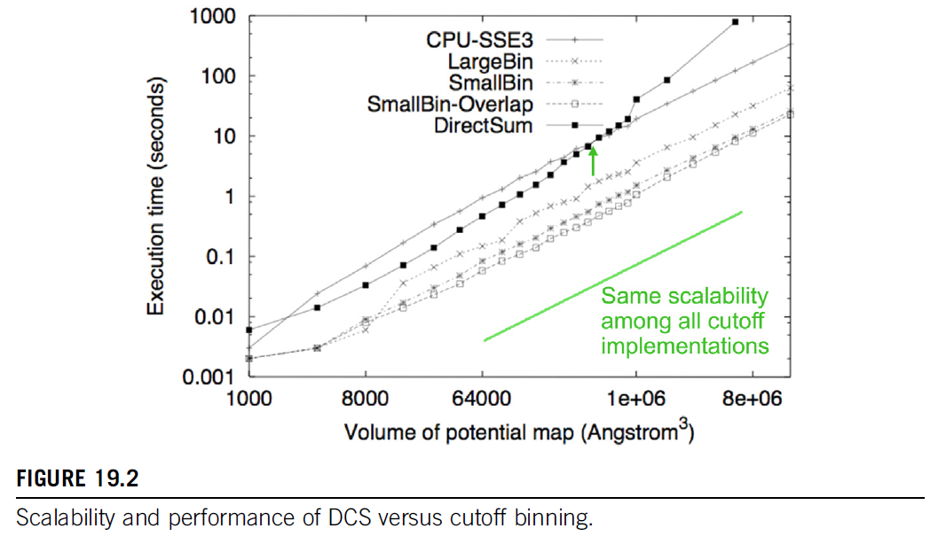

Slide 4
